Slide 1

Lewannick Now and Next

Slide 2

What are currently doing?
Paper recycling

Slide 3
Turn off lights labels

Slide 4
Wildtribe

Slide 5
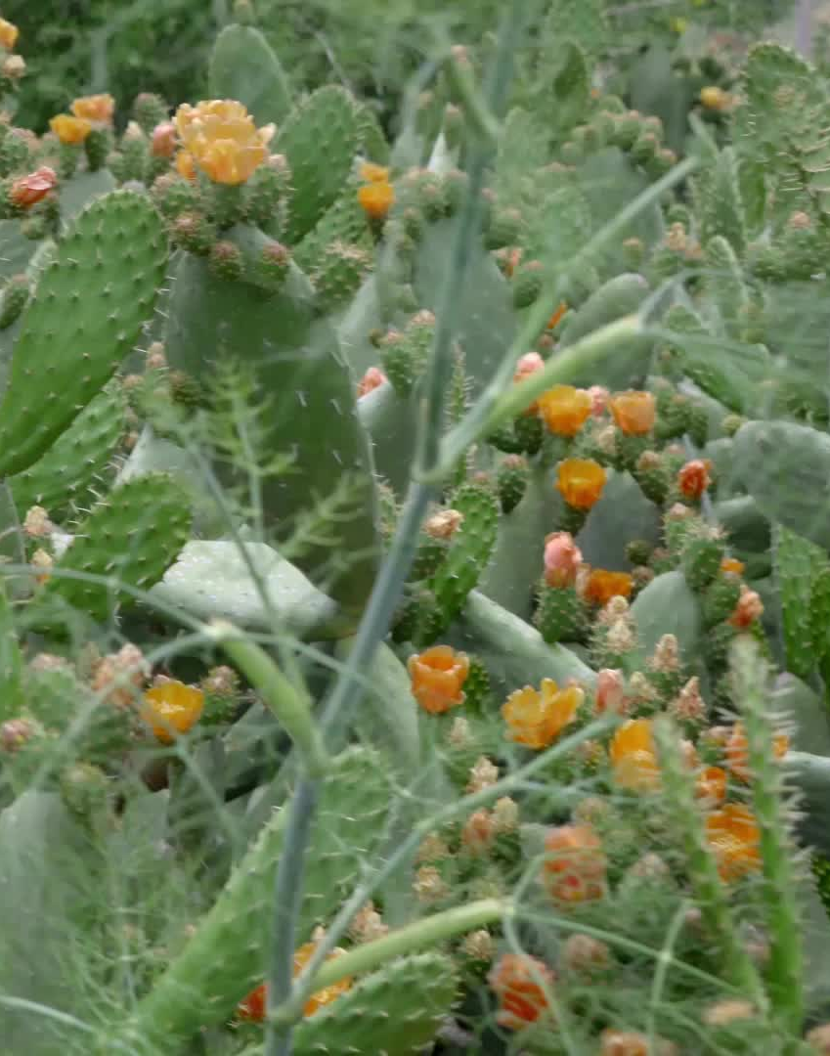
Our current plans
Increase biodiversity around our school site
We are going to:
Fundraise for a hedgehog house or 2
Plan trees and flowers to attract insects
Create plant labels or QR codes to give people information about supporting wildlife

Slide 6
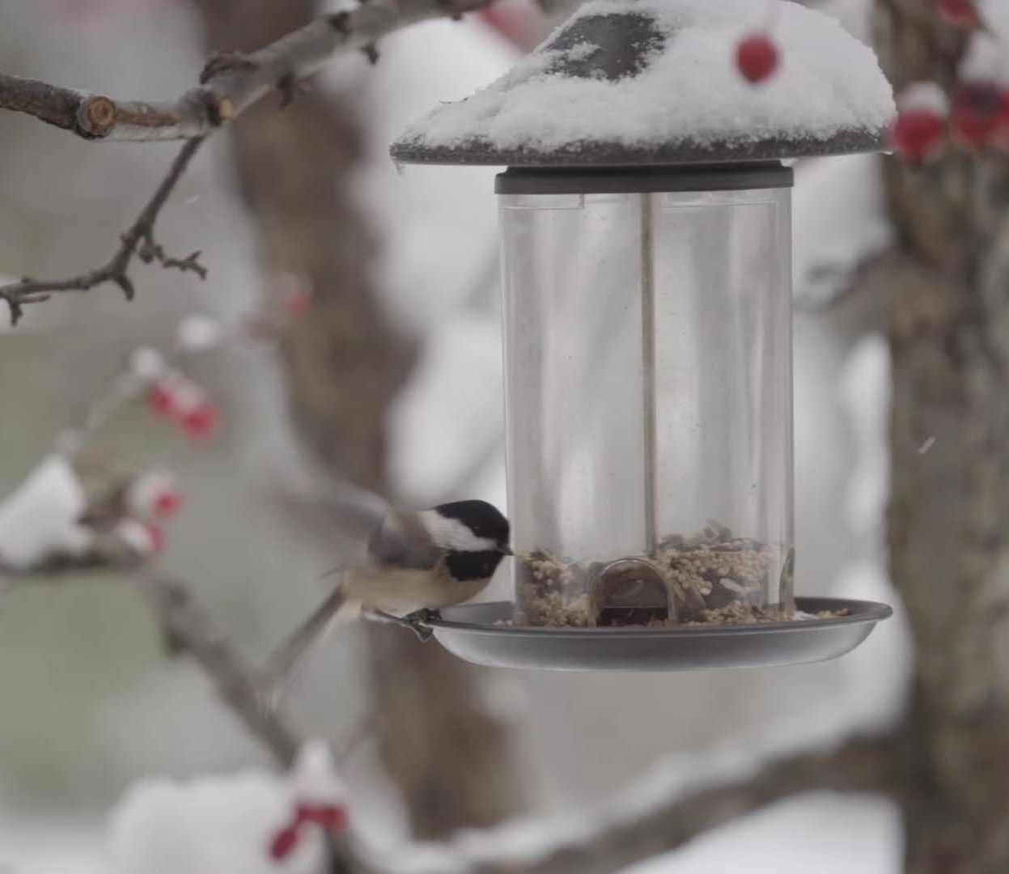
In the future we would like to…..
Build wildlife homes and put in birdboxes and feeders
Do a whole school assembly to get everyone involved
Conduct a wildlife survey before and after our projects

